Slide 1


Moosic
Unsupervised Machine Learning: Clustering Songs
Group 1
Federico, Gözde, Olaf, Zishan

Slide 2

PROJECT OVERVIEW
Moosic:
Small start-up company
Creates curated playlists done by music experts and specialists in old and new trends.
Business Questions:
Are Spotify’s audio features able to categorize music?
Is K-Means a good method to create playlists?

Slide 3

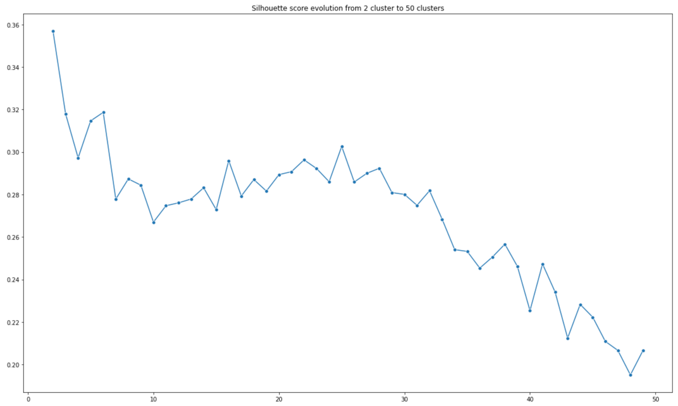


DATA
In our analysis, 5235 songs were used.
Data preparation:
Reading the data
Initial quick exploration
Dropping unwanted features
Modelling:
Data scaling
K-Means exploration of clusters
K-Means final model
Cluster exploration:
Univariate and bivariate exploration of the clusters
Manual labelling of the clusters

Slide 4
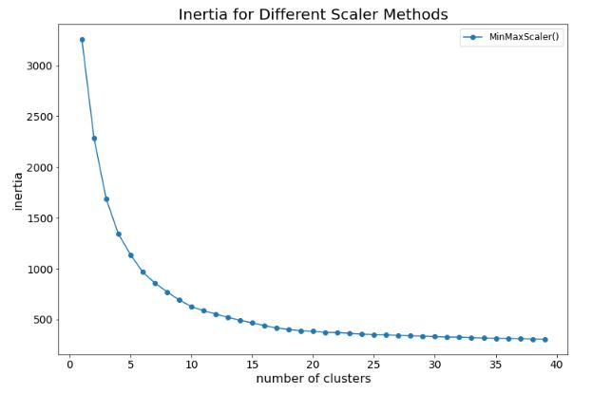
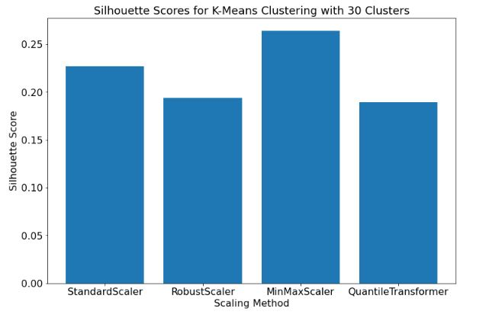
Transformers

Slide 5









FEATURE OVERVIEW
Danceability:
Based on a combination of musical elements such as tempo, rhythmic stability, beat strength, and general regularity.
Instrumentalness:
Predicts whether a track contains no vocals.
Loudness:
Useful for comparing relative loudness of tracks.
Acousticness:
Describes how acoustic a song is.
Speechiness:
Detects the presence of spoken words in a track.
Energy:
A perceptual measure of intensity and activity. Typically, energetic tracks feel fast, loud, and noisy.
Tempo:
The overall estimated tempo of a track in beats per minute (BPM).
Liveness:
Detects the presence of an audience in the recording.
Valence:
Tracks with high valence sound more positive, while tracks with low valence sound more negative.

Slide 6
Playlists
Songs
Number of songs
0) Gloomy classic and jazz
R'n beats
Easy times
Dinner for 2
Shake you boooty
House party cheeeeesy vibes
Random easy listening
Lame house party
Devoured by vermin
Put on your dancing shoes
Pulsating protoplasma
Trashdance
Highway driving
No idea who I am
Trashdance 2, even trashier
Slow extinction of life
On the hill of desecration
Melodical pop rock
Melodical pop rock 2, with some energy...
Yo bro
Mixed ultracheeesy energy dance
A good book, some wine and a fireplace
Close your eyes
Melodical pop rock 3, it gets romantic...
Where the rivers of the madness stream
Very drunk disco pub dj
Trash melodic pop rock
Tropical Summer breeze
Confused AI
29) RIP Mr. Reed
164
269
170
161
180
370
150
82
138
180
243
84
184
201
108
299
98
232
343
219
66
93
169
192
173
170
195
74
48
180

Slide 7
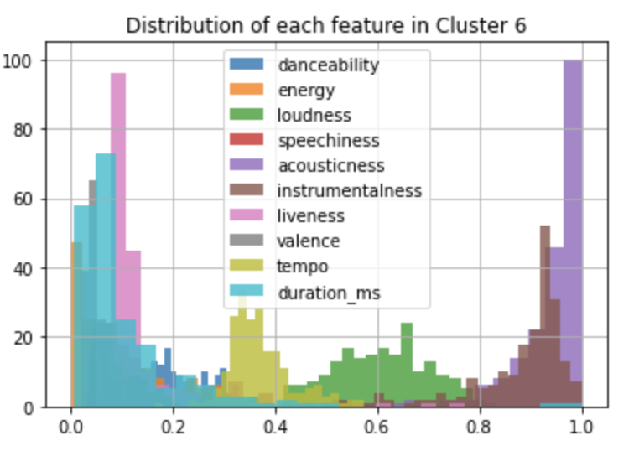
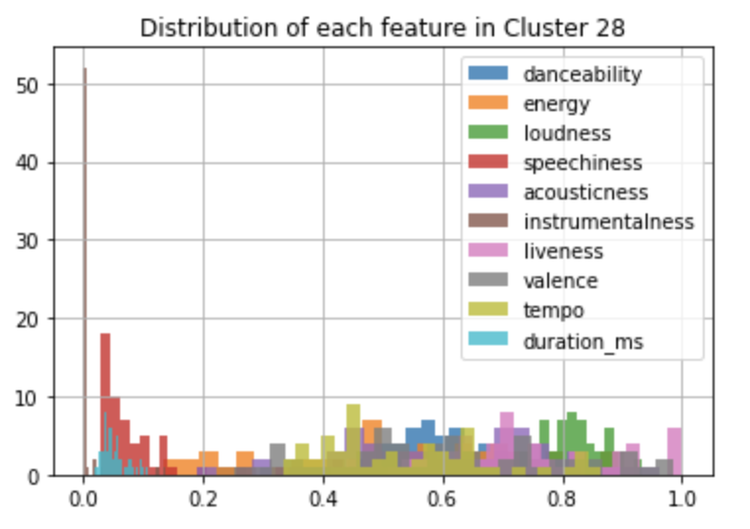
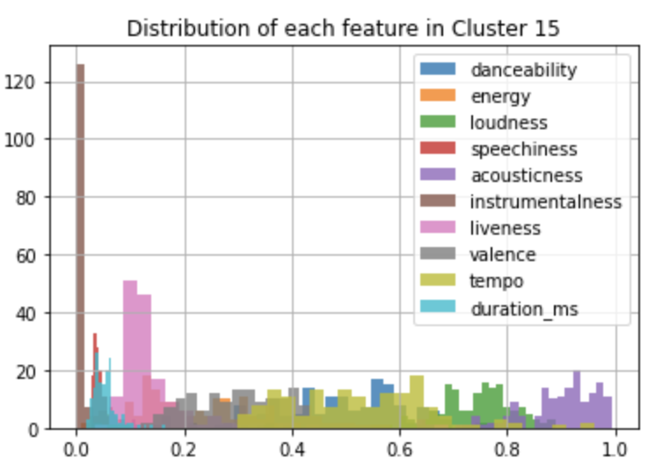
Playlists
6) Random easy listening
Link 1
Link 2
28) Confused AI
Link 1
Link2
15) Slow extinction of life
Link 1

Slide 8
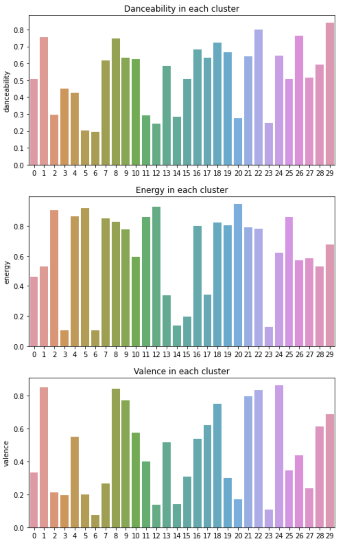
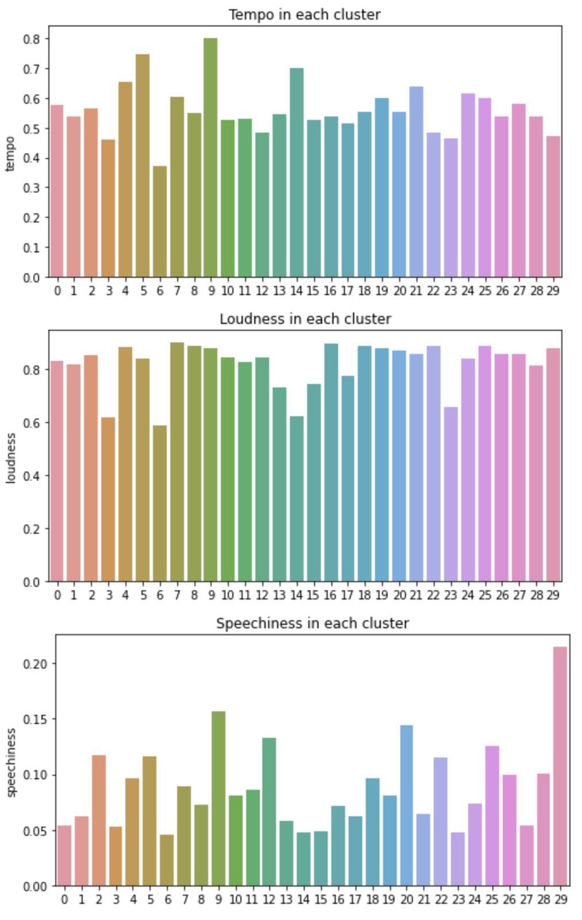
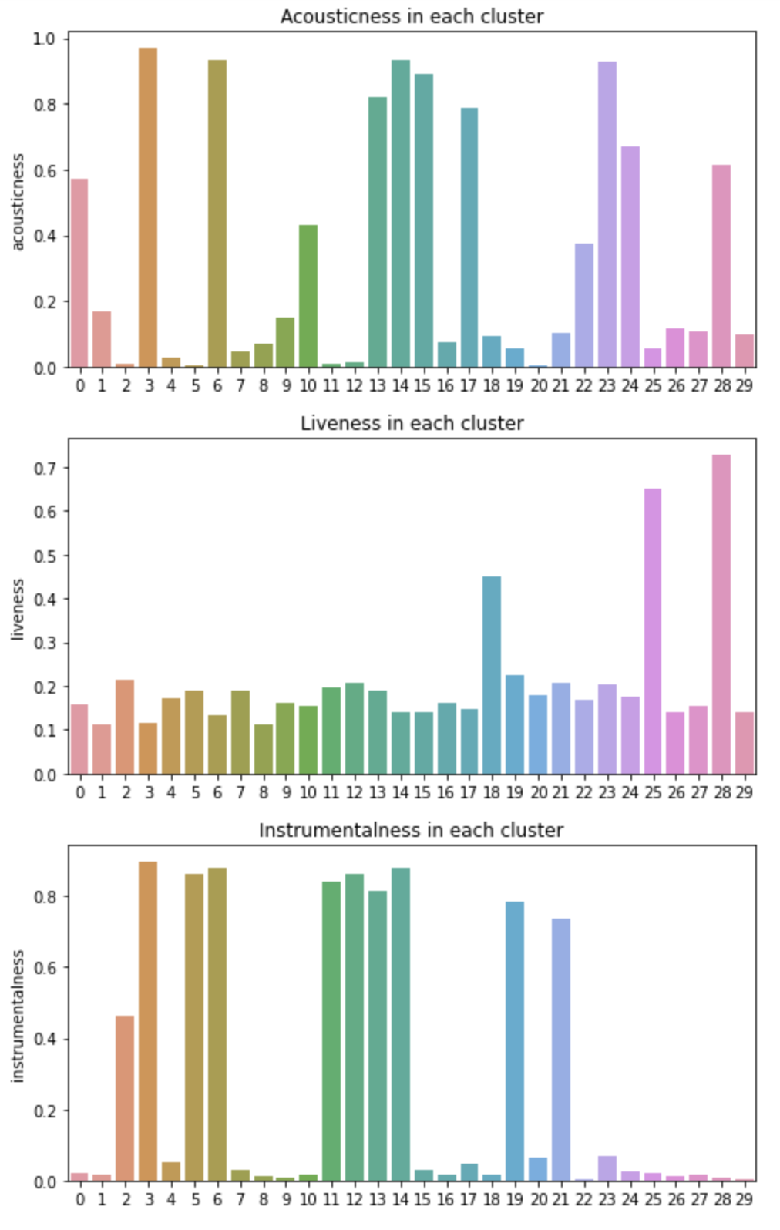

Slide 9
CONCLUSIONS
Spotify's audio features manages to get logical playlists
K-Means method create playlist based on certain audio features so may not always produce pleasing group of songs
It can be useful to use other features like genre labelling to improve clustering

Slide 10

THANK YOU
ANY QUESTIONS?

